Slide 1

JAYOTI VIDYAPEETH women’s
university, Jaipur, INDIA
TOPIC: BUS structures
Presented by,
JV’n PUJA Kumari

Slide 2
INTRODUCTION:
The system bus is a pathway composed of cables and connectors used to carry data between a computer microprocessor and the main memory.
The bus provides a communication path for the data and control signals moving between the major components of the computer
system. In the computer bus is a sub system that transfer Data between different component of the compute.
Early compute Use electrical wire to connect between components today’s computer Uses parallel and bit serial connection. The structure of the article is an
Follows. The first place the structure optimization process in decribed , afterward,
It is shown the finite element modal used in the structural optimization, further More , the genetic algorithm is described as fundamental part of the optimization
Process , next the search space and fitness function are stated due to importantRoll they play in the optimization process

Slide 3
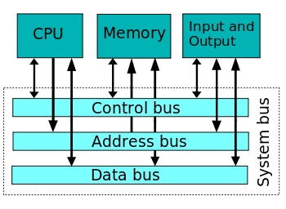
Basic bus :

Slide 4
Characteristics of a bus :
In computers, a bus is defined as a set of physical connections that is wires or cables that are used to transmit data. They can be shared by multiple hardware components in order to communicate with one another. A computer bus is thus characterized by the amount of data or information that it can transmit at once. This amount is expressed in bits and it corresponds to the number of physical lines over which data is sent simultaneously. For instance, a 32-bit bus can transmit 32 bits in parallel

Slide 5
conclusion:
The simple bus systems had a critical setback when used for general-purpose computers. The entire devices placed directly on the bus had to operate at the same speed dictated by the bus. As they all shared a single clock system. It became a hard task when increasing the speed of the central processing unit is the aim. Because to achieve this, the speed of all the devices on the bus just as well be increased.
It then became almost not practical or economical to have all the computer components/devices to have the same speed as the CPU. So, the CPU has to wait or work at a very ridiculous slower clock frequency to communicate with other devices in the computer system. While acceptable in embedded systems, this problem was not for long tolerated in general-purpose and also in user-expandable computers. Such bus systems are difficult also to set up when constructed from regular off-the-shelf tools/equipment.

Slide 6


